Slide 1
What should a
media specialist
always have in their
media center?

Slide 2
Media Specialists should
always have…
Library Displays
&
Bulletin Boards!!!

Slide 3
Authentic Problem
They take too much time and energy to put up
They are not creative or engaging
They are not updated frequently
They get torn down by students
(Goodnough, 2002)
They are used as decorations, not as a teaching tool (Young, n.d.)

Slide 4
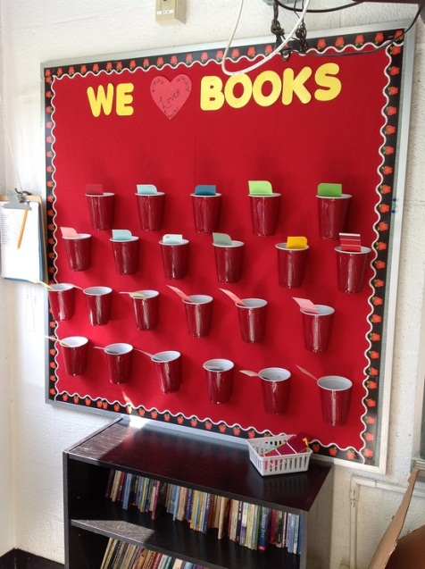
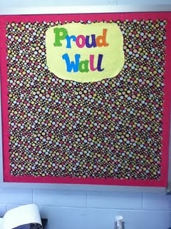
Why am I advocating for library displays and bulletin boards?
When designed and created with a purpose, they are…
http://pinterest.com/pin/21251429464151392/
Engaging and Motivating (Young, n.d.)
Welcoming
Show progress
Show student work
  Don’t just show the “best work,” let the students choose the work they wish to display (Haskvitz, 2002)
http://pinterest.com/pin/21251429462103518/

Slide 5
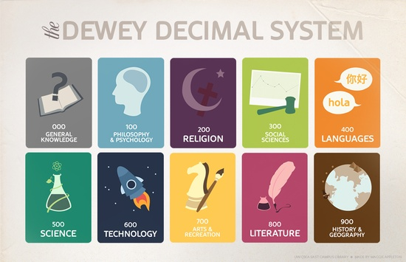
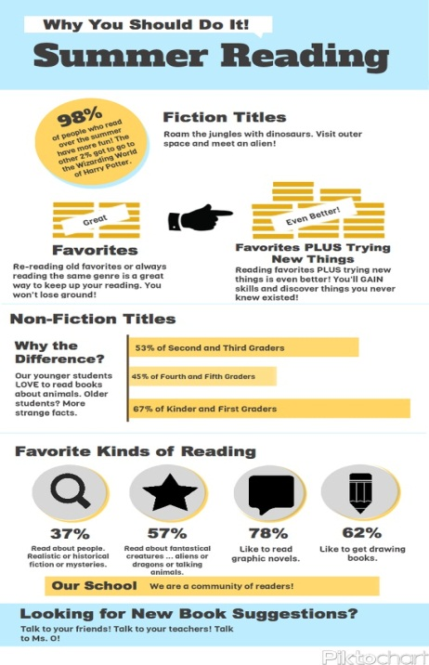
Communicate Essential Information (Young, n.d.)
Rules, rewards, directions, policies, etc.
Newsletters, events, programs, etc.
Classroom jobs
http://pinterest.com/pin/21251429462181543/
http://pinterest.com/pin/61291244899437940/

Slide 6
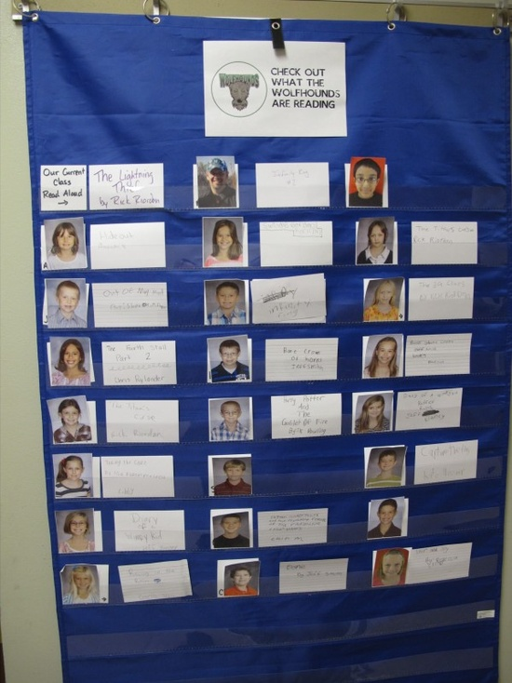
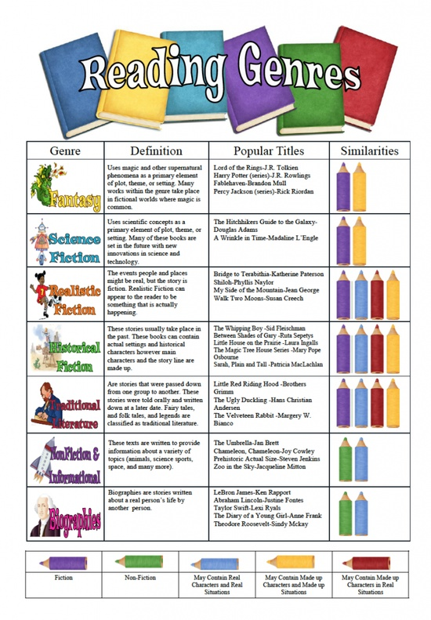
Reinforce Instructional Goals (Young, n.d.)
Learn how to…write book reviews/ recommendations, search using the OPAC, etc.
Reflect on the class
Post objectives and goals for the day
http://pinterest.com/pin/21251429463374825
/
http://pinterest.com/pin/21251429461607794/

Slide 7
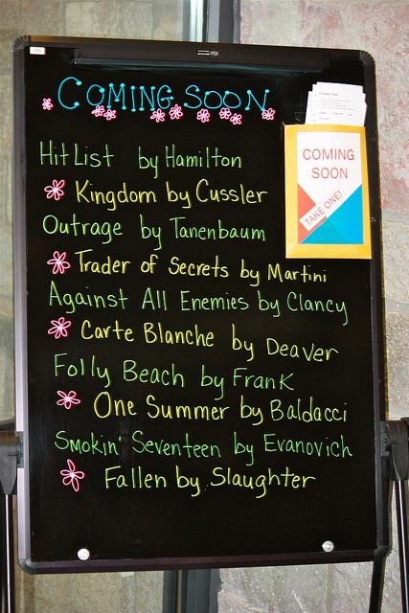
Most importantly…
“A school librarian must actively market the school library media program” (Carrigan, 2010)
Use them to promote and advocate for the library and your role as a media specialist!
Display new technology ideas and how to use them
Draw people in by displaying new or old books
List the ways you can help students and faculty
Communicate and share your success (Carrigan, 2010)
http://pinterest.com/pin/21251429461138190/

Slide 8
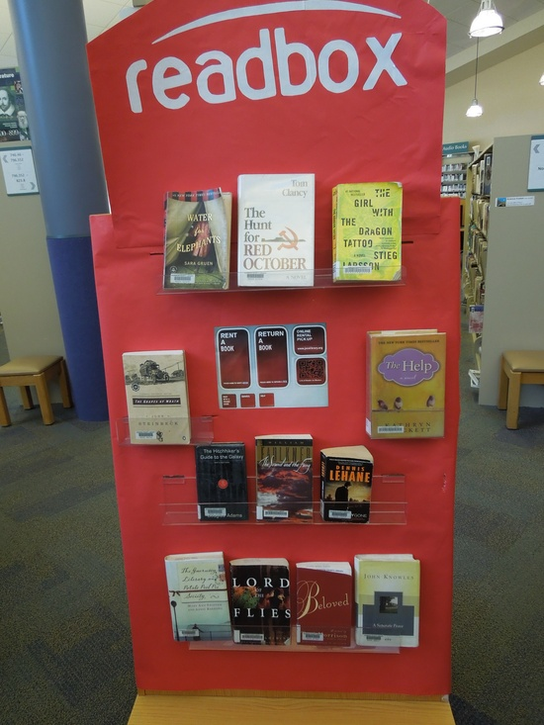
Using displays and bulletin boards that are appropriate and purposeful, can be used to advocate for you and your school library!
Just remember to…
Update them frequently
Use them as a tool, not just for decoration
Keep it simple, don’t overwhelm (Cook, 2006)
Make them exciting, creative, and welcoming
And have fun!
http://pinterest.com/pin/61291244900335298/

Slide 9
PLN/ Social Media Involvement
http://informania.wordpress.com/2012/02/26/three-for-awesome-ideas-for-library-displays/#comment-1383
(my comment is at the bottom; the most recent one)
http://memw.edublogs.org/2007/11/14/library-display-ideas/comment-page-1/#comment-269
(my comment is at the bottom; the most recent one)

Slide 10
Sites used for display ideas and pictures
AASL Essential Links (Library Displays and Bulletin Boards)
http://aasl.ala.org/essentiallinks/index.php?title=Library_Displays_and_Bulletin_Boards
http://pinterest.com/pin/21251429464151392/
http://pinterest.com/pin/21251429463374825
http://pinterest.com/pin/21251429462181543/
http://pinterest.com/pin/21251429461607794/
http://pinterest.com/pin/21251429461138190
http://pinterest.com/pin/21251429462103518/
http://pinterest.com/pin/61291244899437940/
http://pinterest.com/pin/61291244900335298/

Slide 11
References
Carrigan, J. (2010). Advocacy: Promotion: Public relations, advertising, and marketing. Retrieved from http://eduscapes.com/sms/advocacy/promotion.html
Cook, H.M. (2006). Get the message? Designing displays, bulletin boards, and signage for libraries and schools [PowerPoint slides]. Retrieved from http://www.easternct.edu/smithlibrary/depts/curriculum/documents/DesigningDisplayspresentation.pdf
Goodnough, A. (2002). Judging a school by its posters: Bulletin boards are scrutinzed and fretted over. Retrieved from http://www.nytimes.com/2002/06/18/nyregion/judging-a-school-by-its-posters-bulletin-boards-are-scrutinized-and-fretted-over.html?pagewanted=all&src=pm
Haskvitz, A. (2002). Bulletin board ideas. Retrieved from http://www.reacheverychild.com/feature/bulletin_board.html
Young, D. (n.d.). Bulletin boards and other displays. Retrieved from http://www.learnnc.org/lp/pages/733

